Slide 1
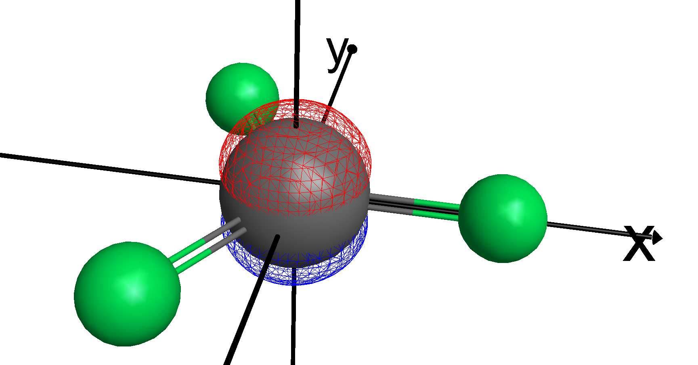
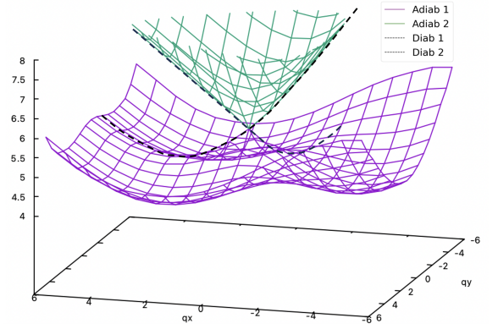
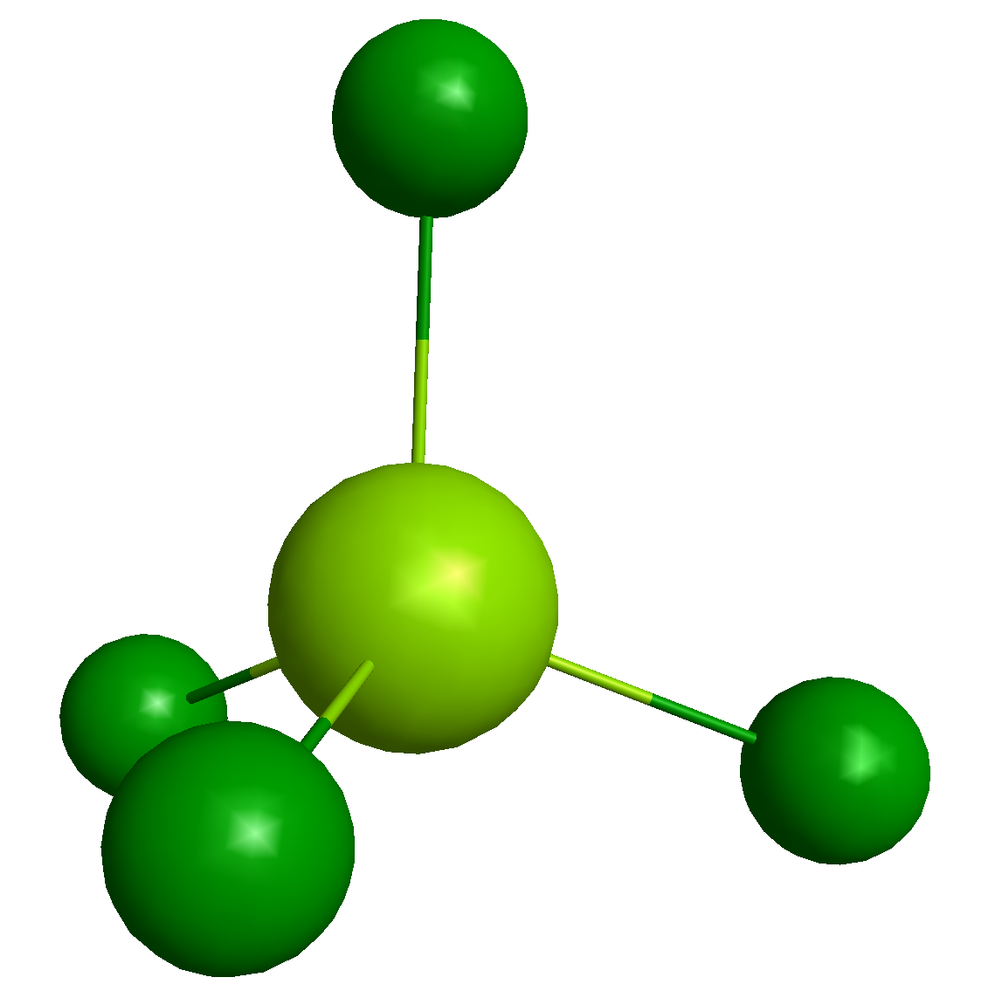

CoF3 Protocol
Julian Schwinger’s Oscillator Model for Angular Momentum
PHYS 5000 – Literature Project
Guoying Yao & Benny Chen
Notes:
Everyone

Slide 2
Examples
Using Schwinger’s model
Notes:
Claire

Slide 3
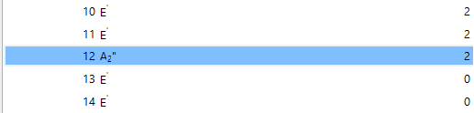

Introduction – CoF3, no valence electrons (30+ charge cation)
Occupation number
12 is HOMO, 2pz

Slide 4
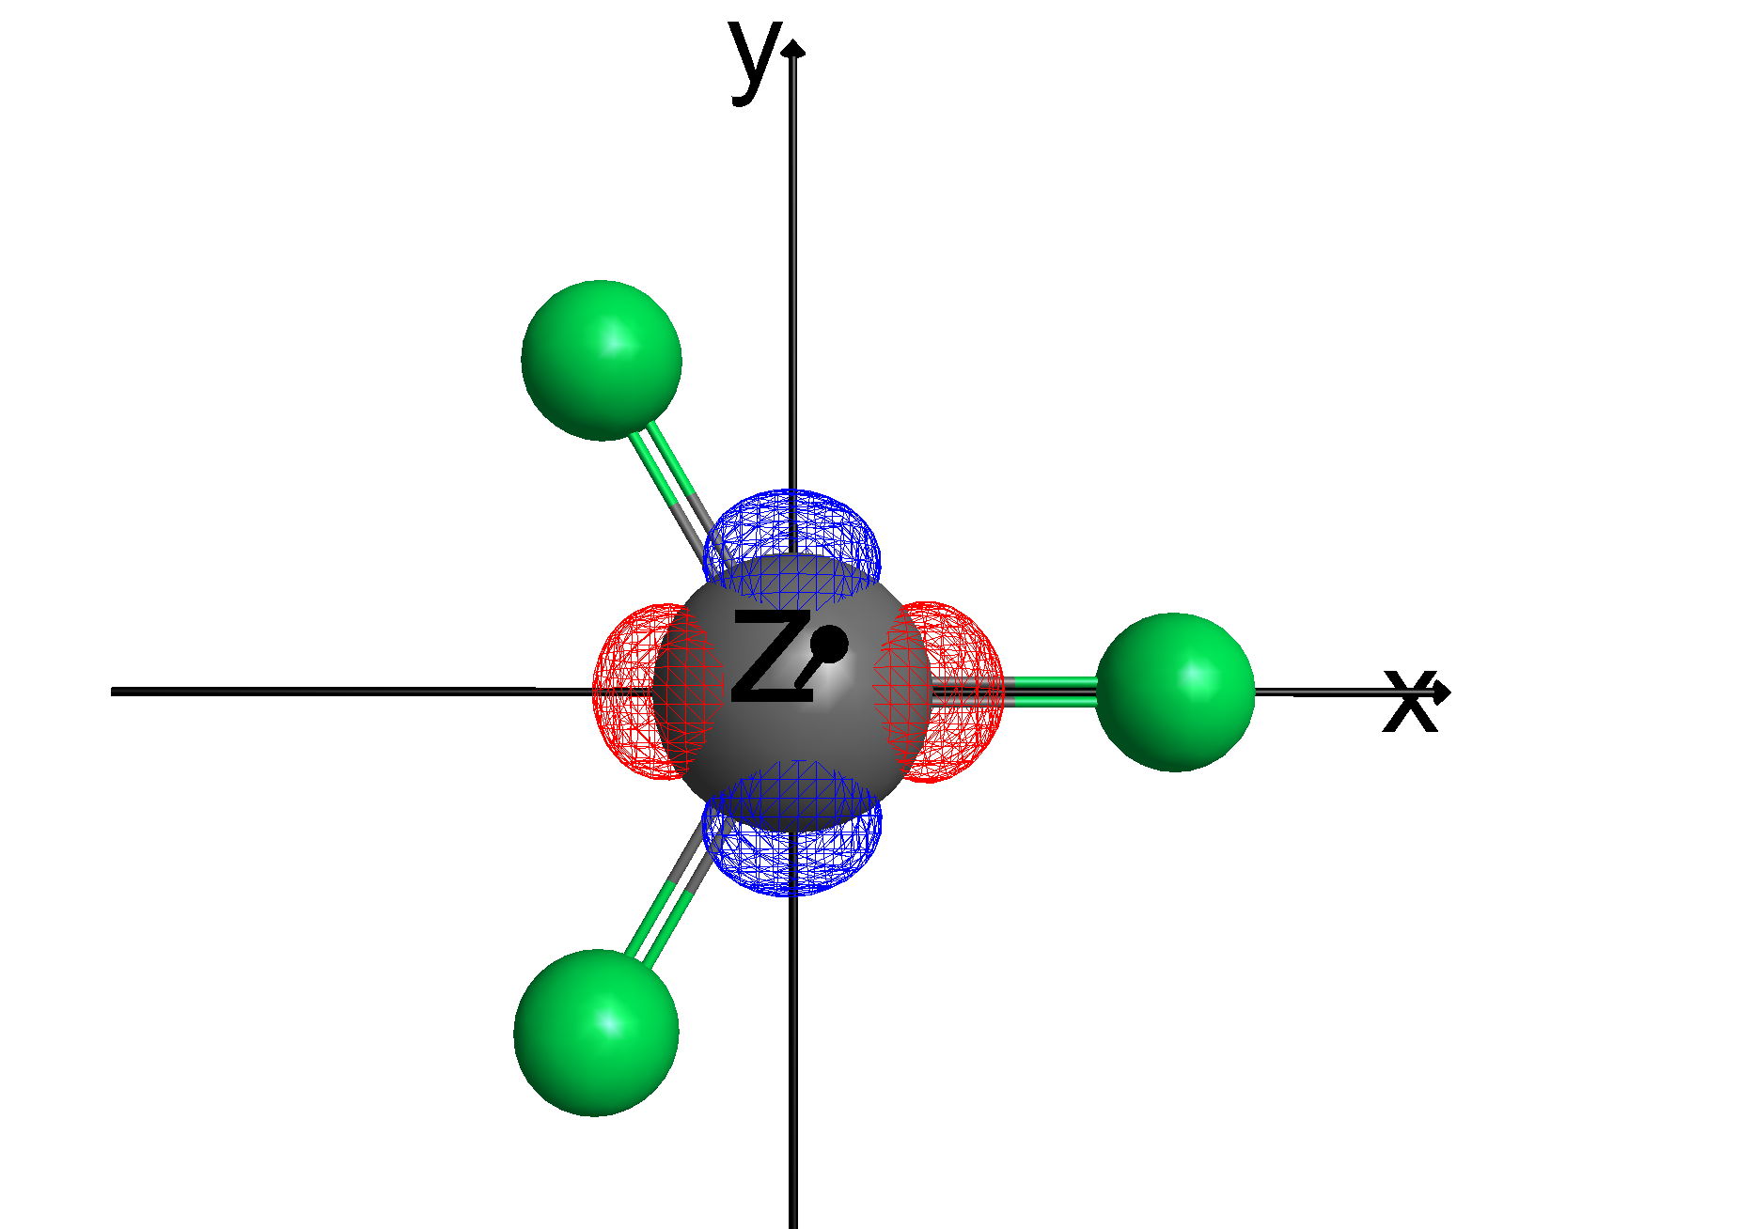
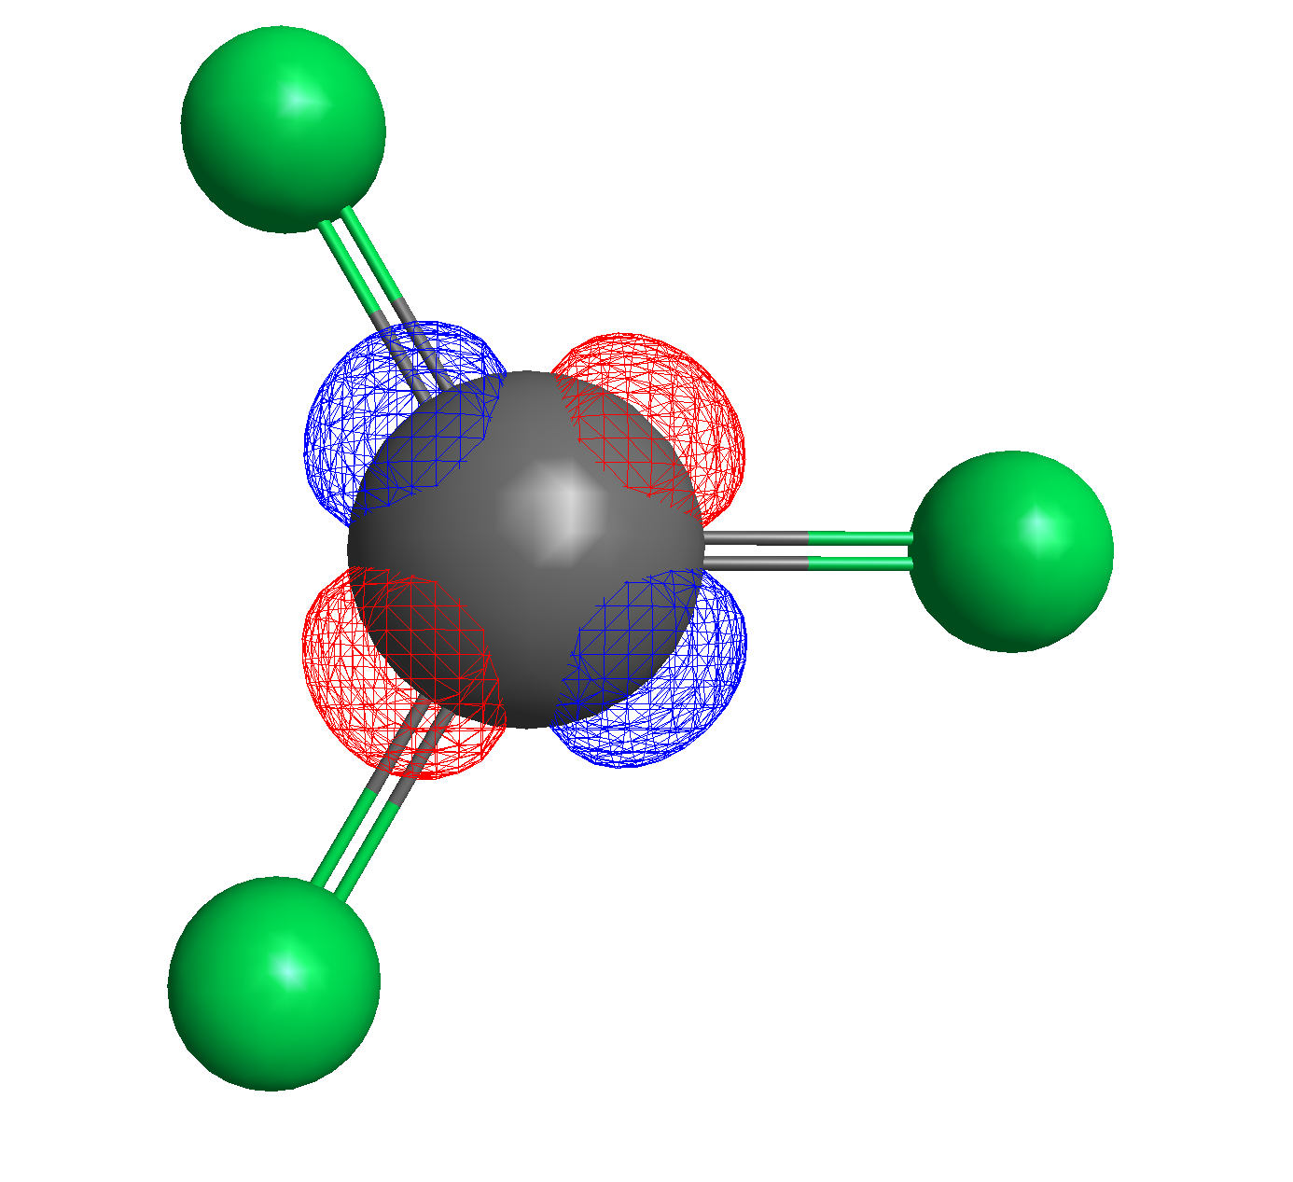
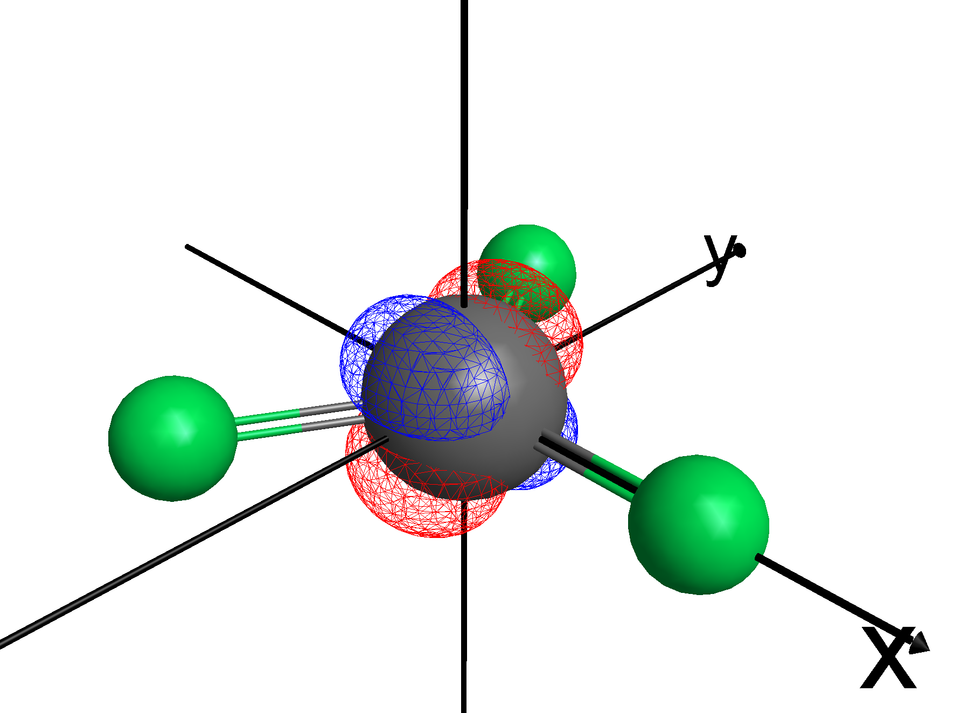
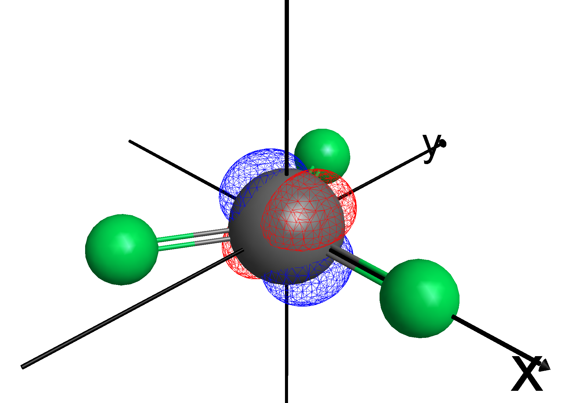
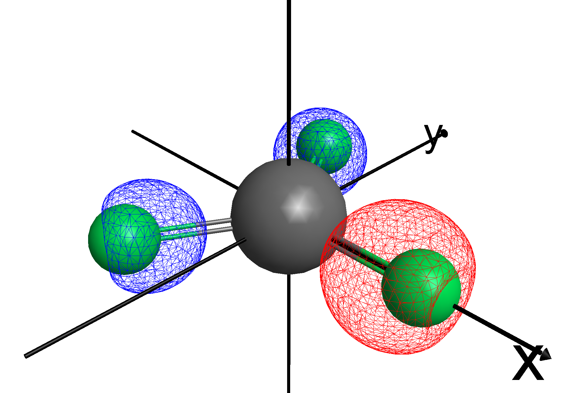
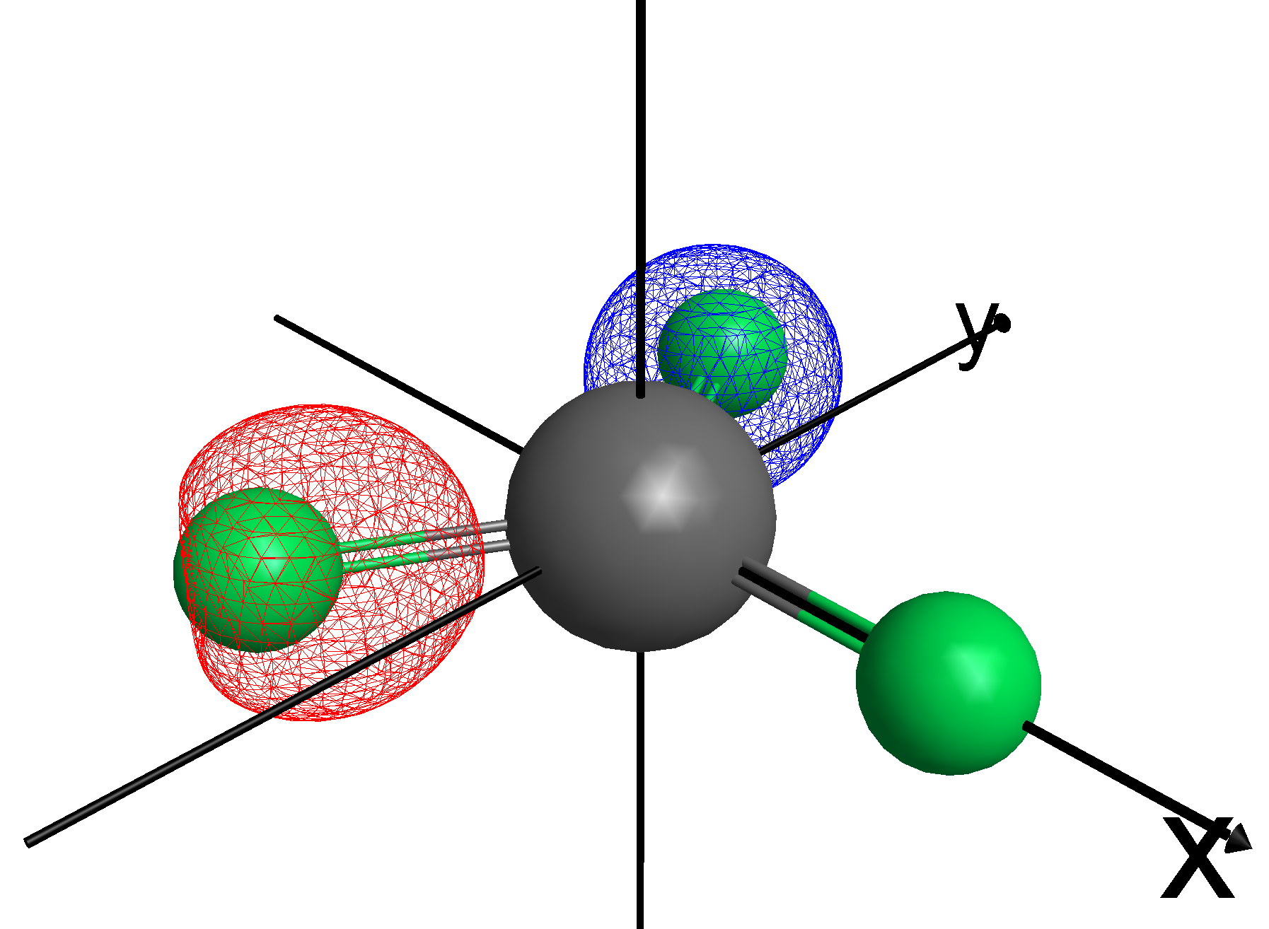
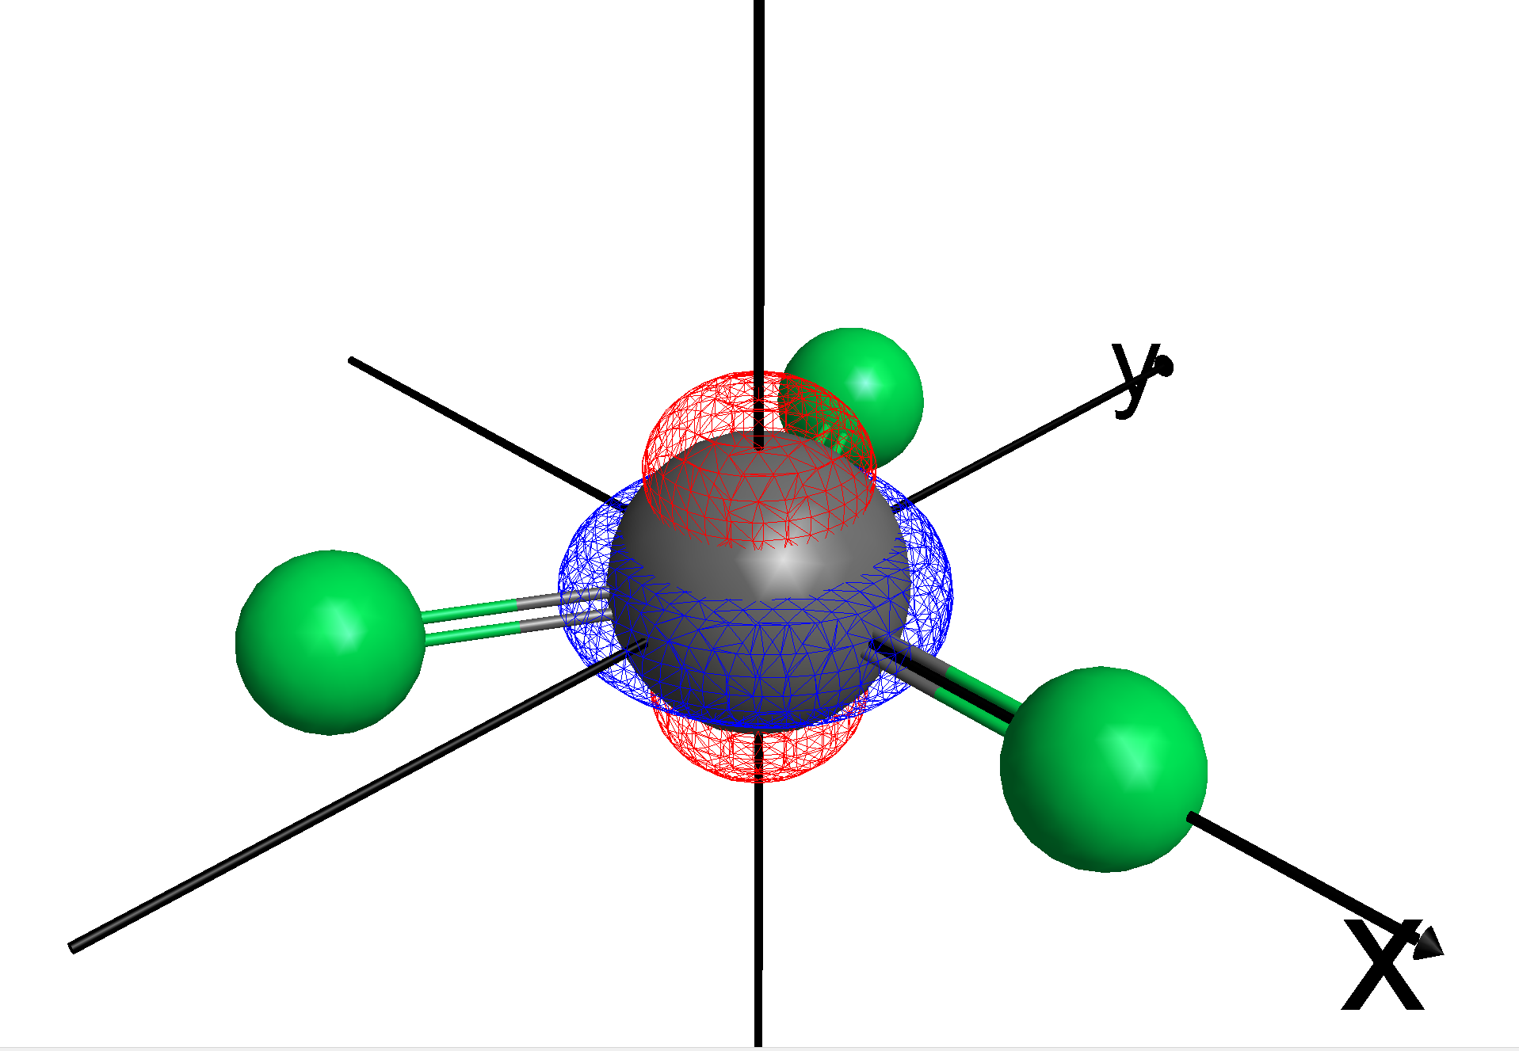
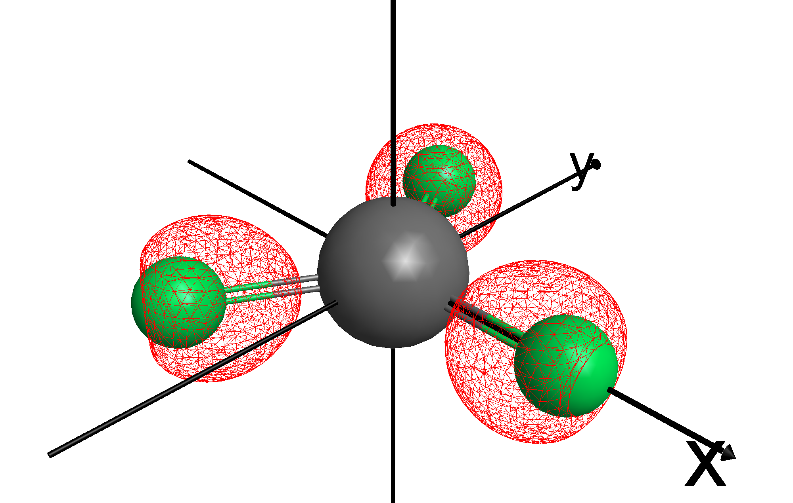
13 – dx²-y²
14 - dxy
15 - dyz
16 - dxz
17 - dz²
18 – 2s (A1’)
19 – 2s (E’)
20 – 2s (E’)
Notes:
M always increases or decreases by 1 under ladder operators acting.

Slide 5
13 – 2s (A1’)
14 - 2s (E’)
15 - 2s (E’)
16 - dx²-y²
17 - dxy
18 – dyz
19 – dxz
20 – dz²
Notes:
M always increases or decreases by 1 under ladder operators acting.

Slide 6
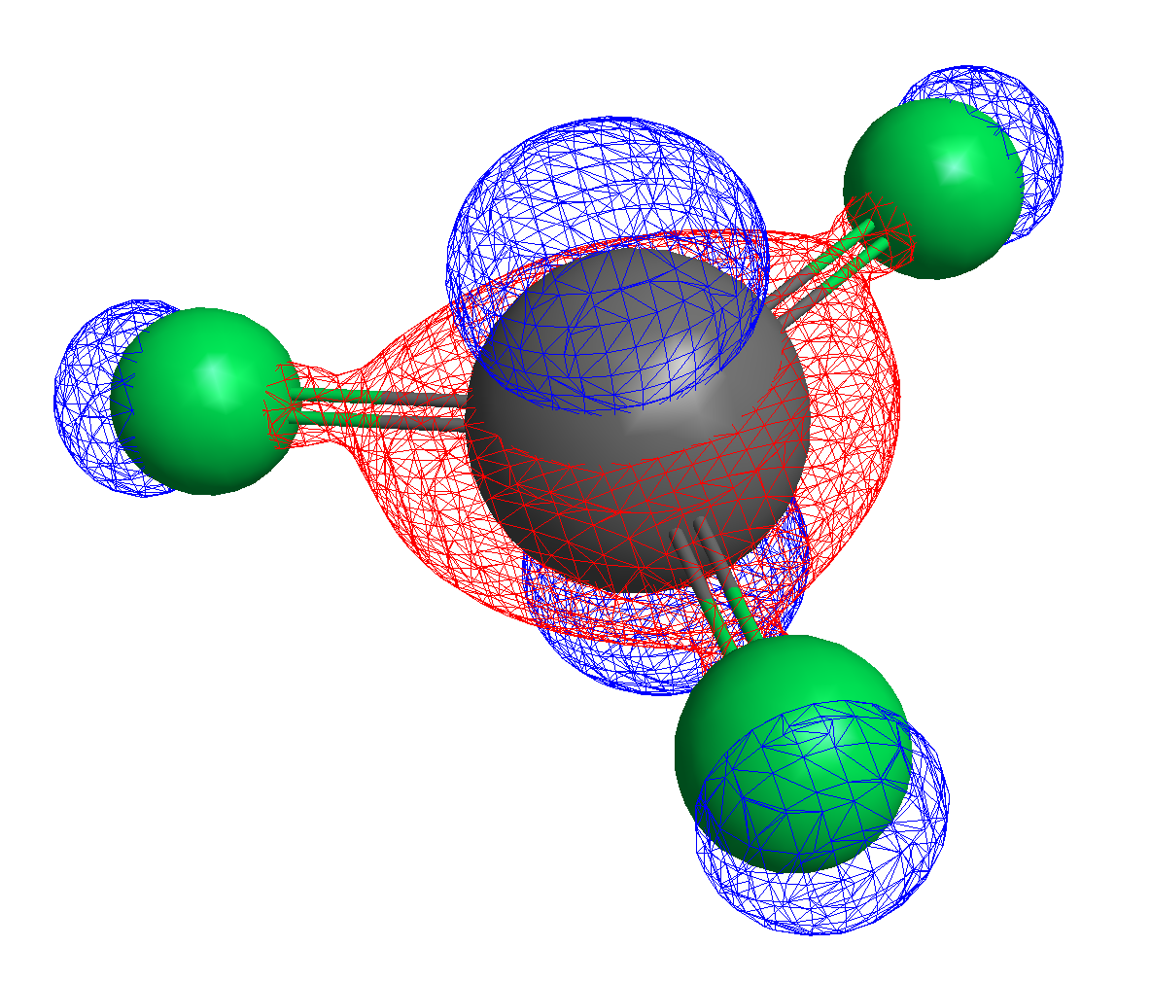
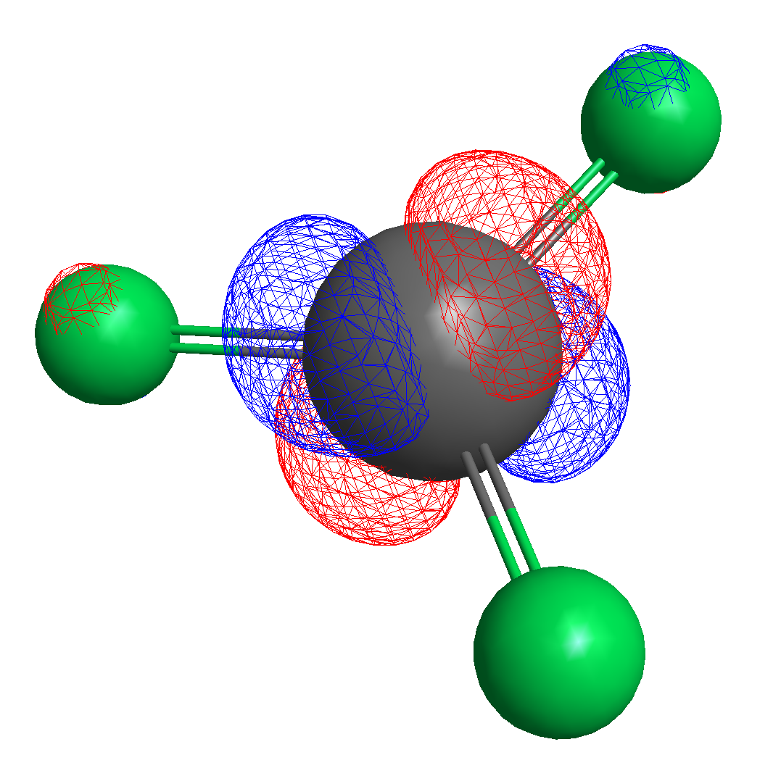
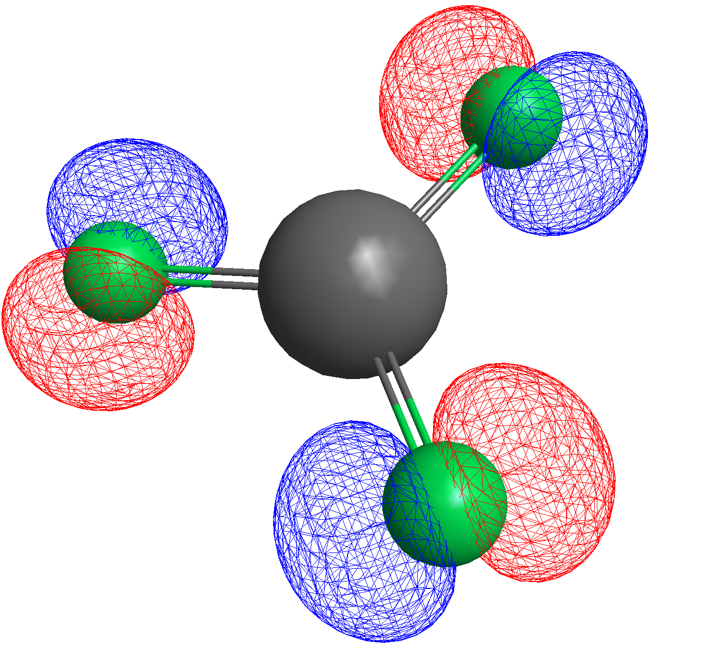
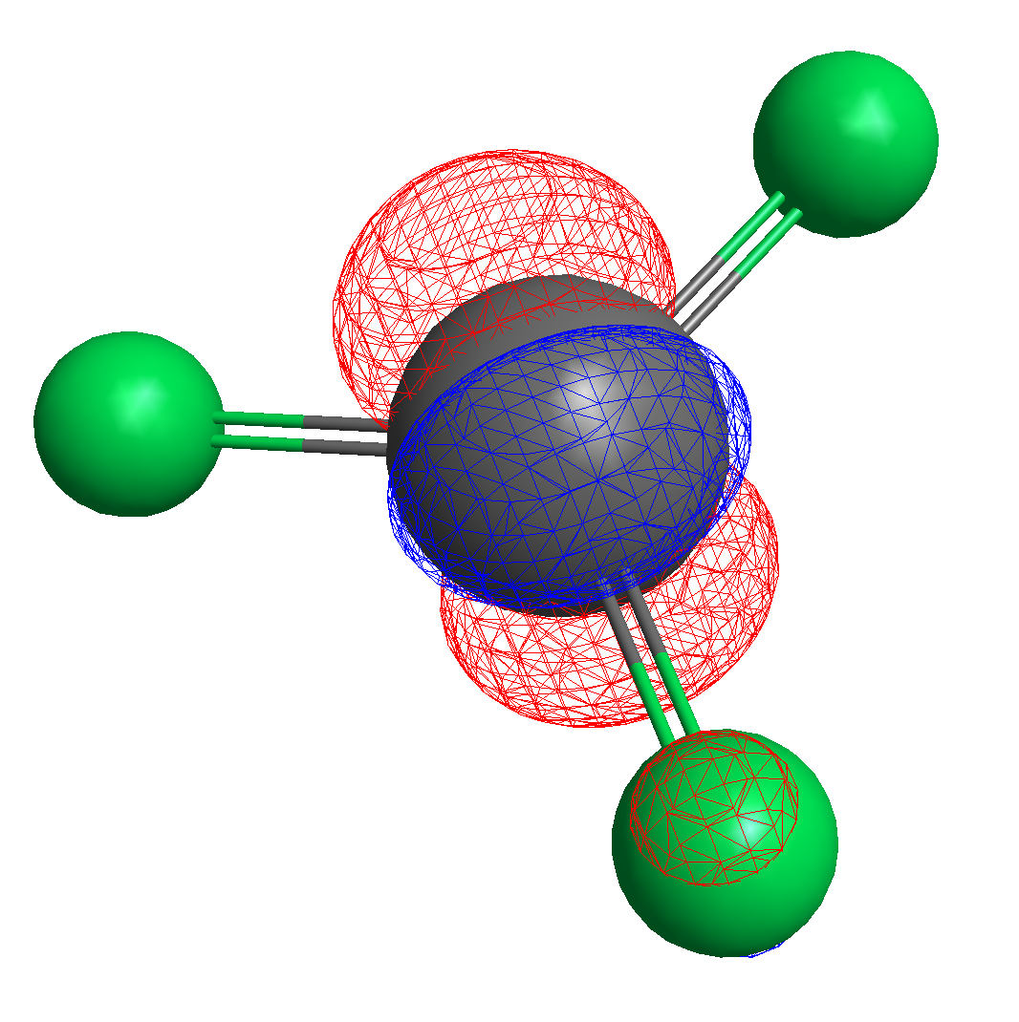
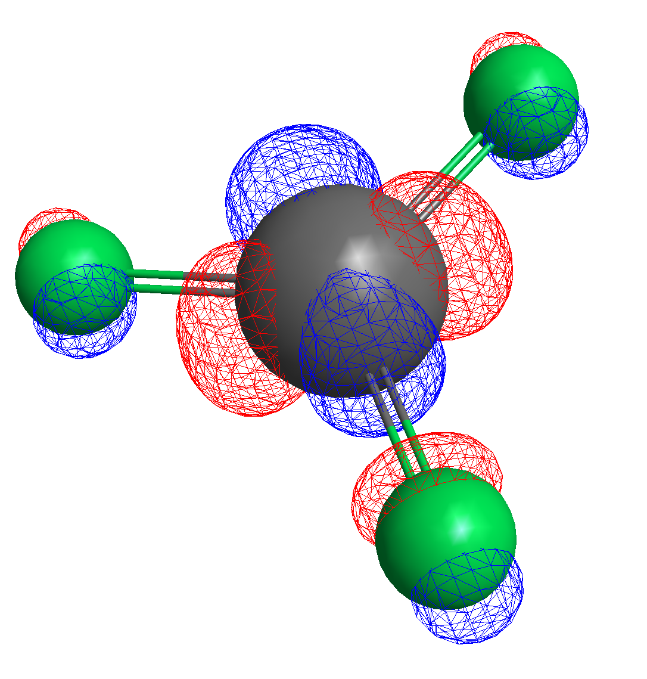
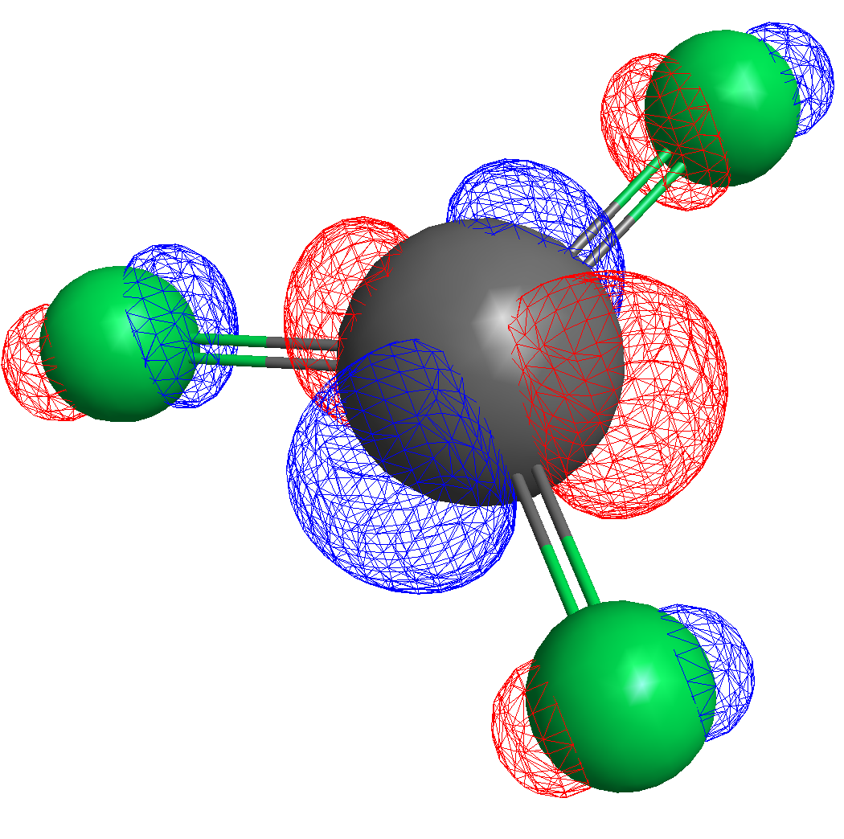
16 – dz²
25
26 – dyz
27 - dxz
28 – dx²-y²
29 – dxy
Notes:
M always increases or decreases by 1 under ladder operators acting.

Slide 7
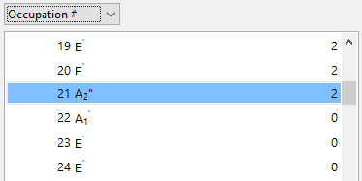
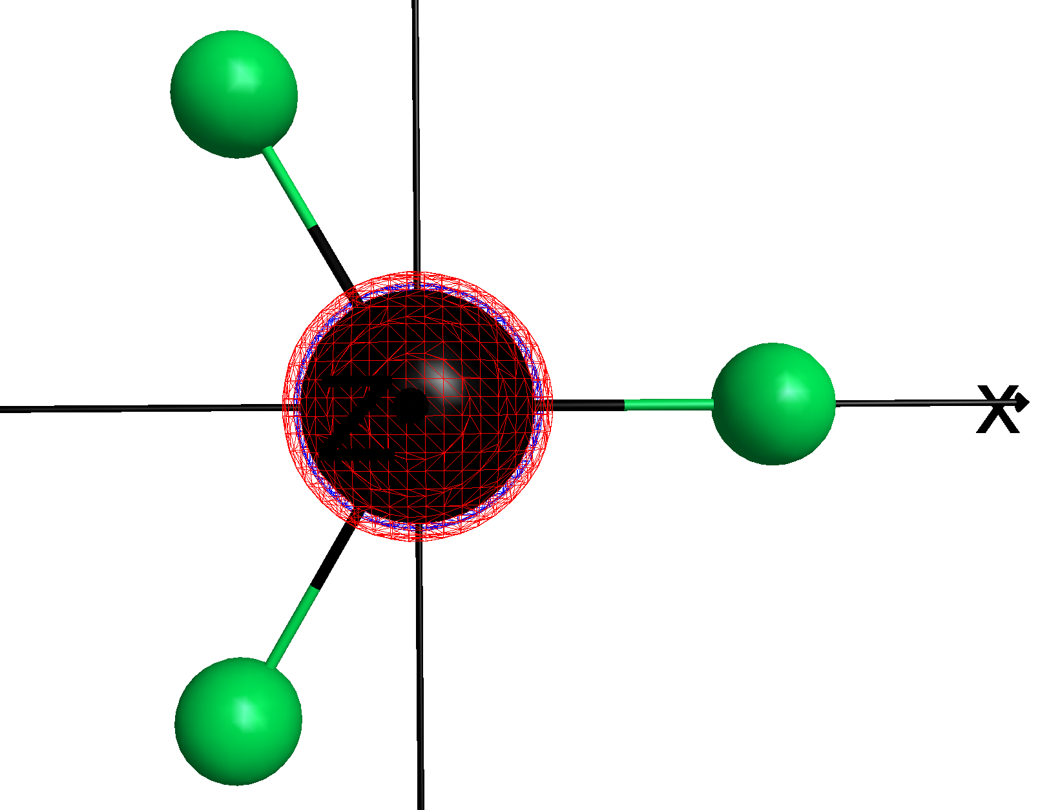
RhF3, no valence electrons (30+ charge cation)
Occupation number
21 is HOMO, 3pz

Slide 8
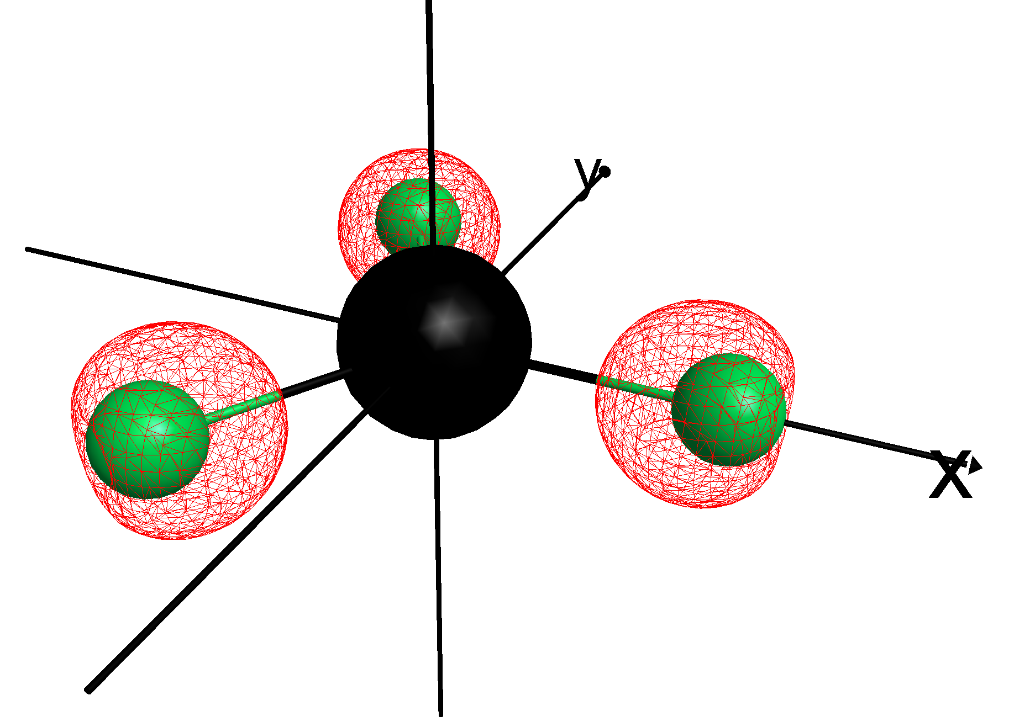
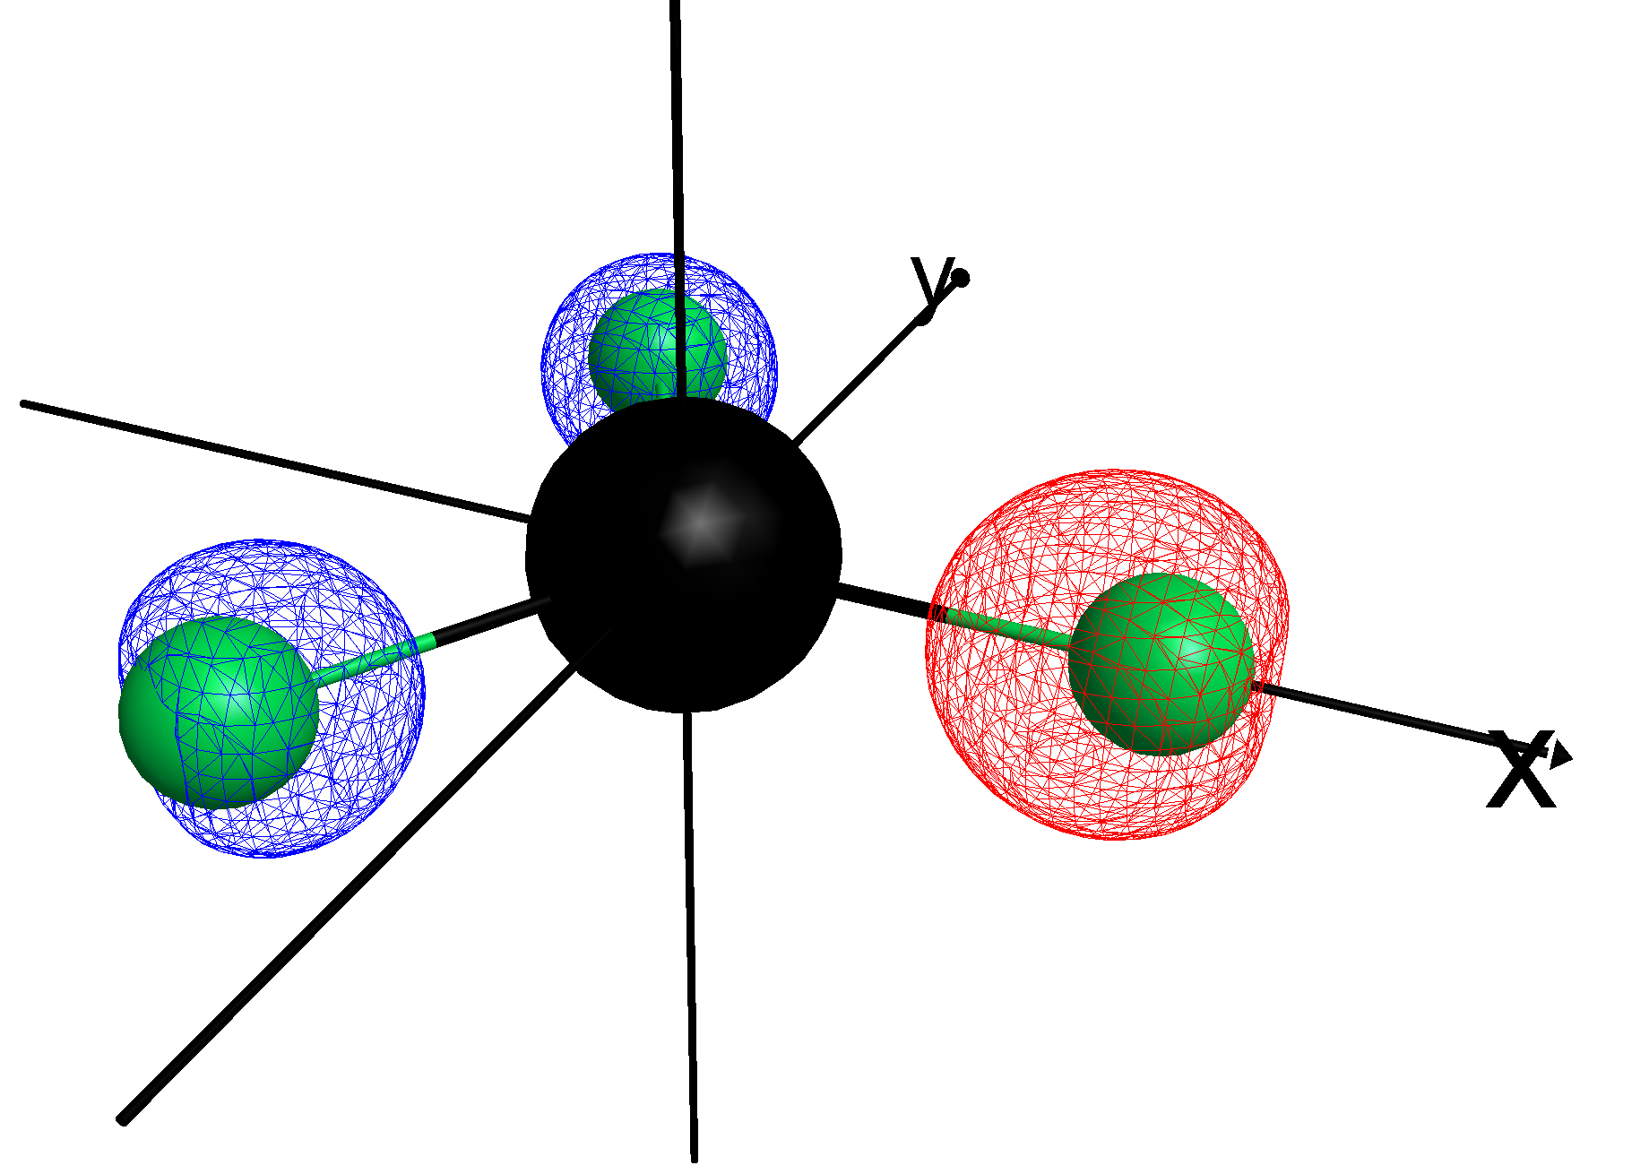
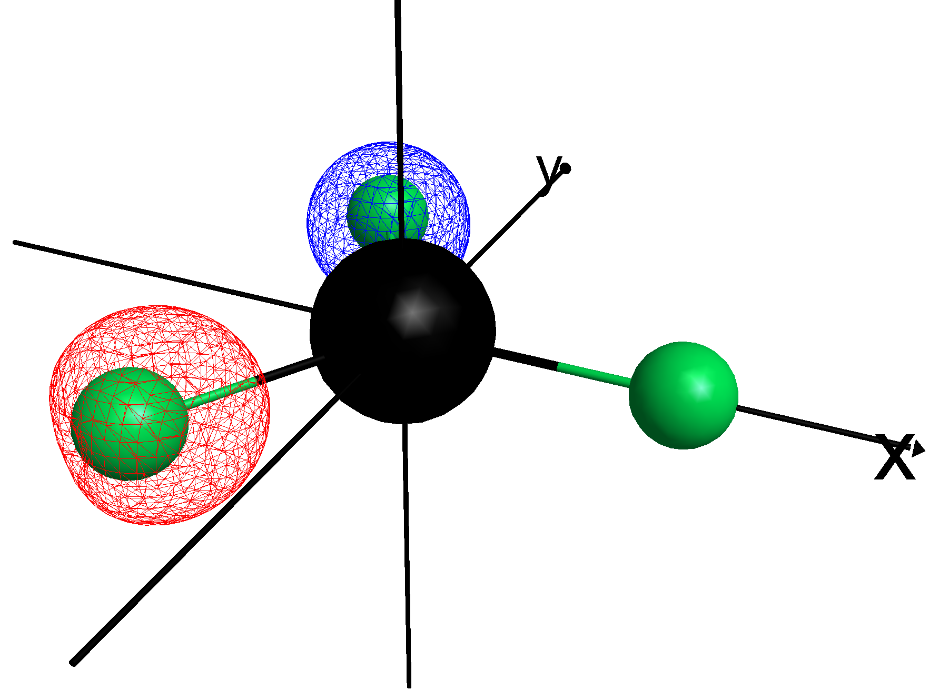
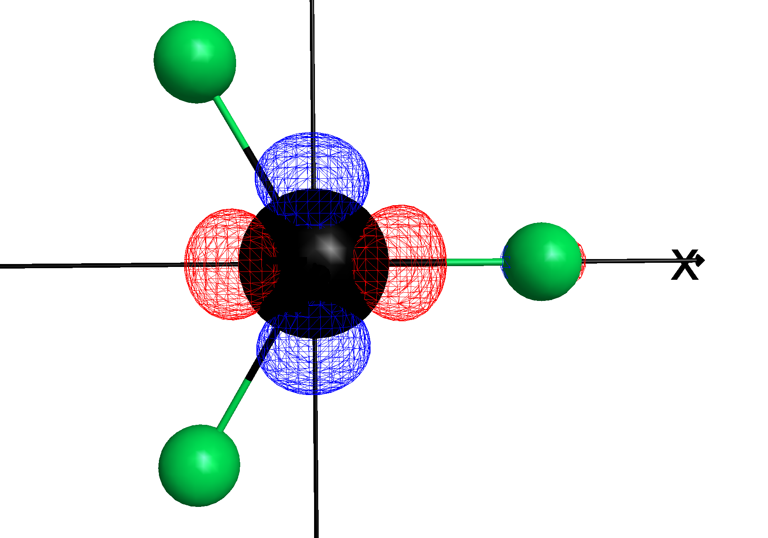
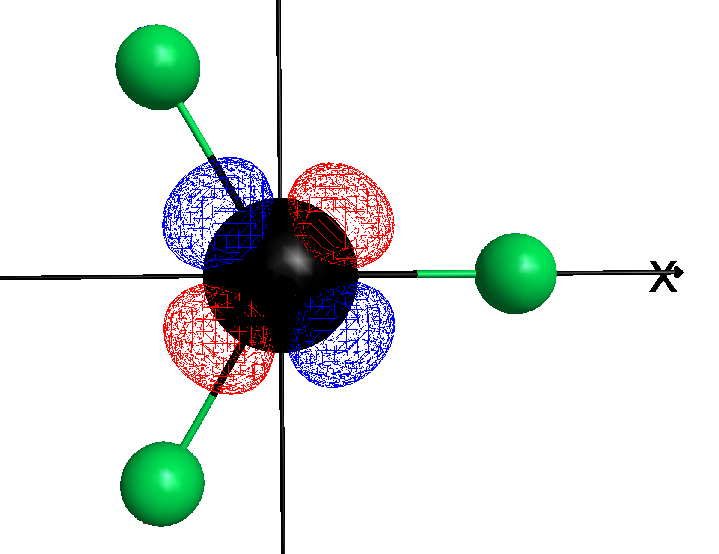
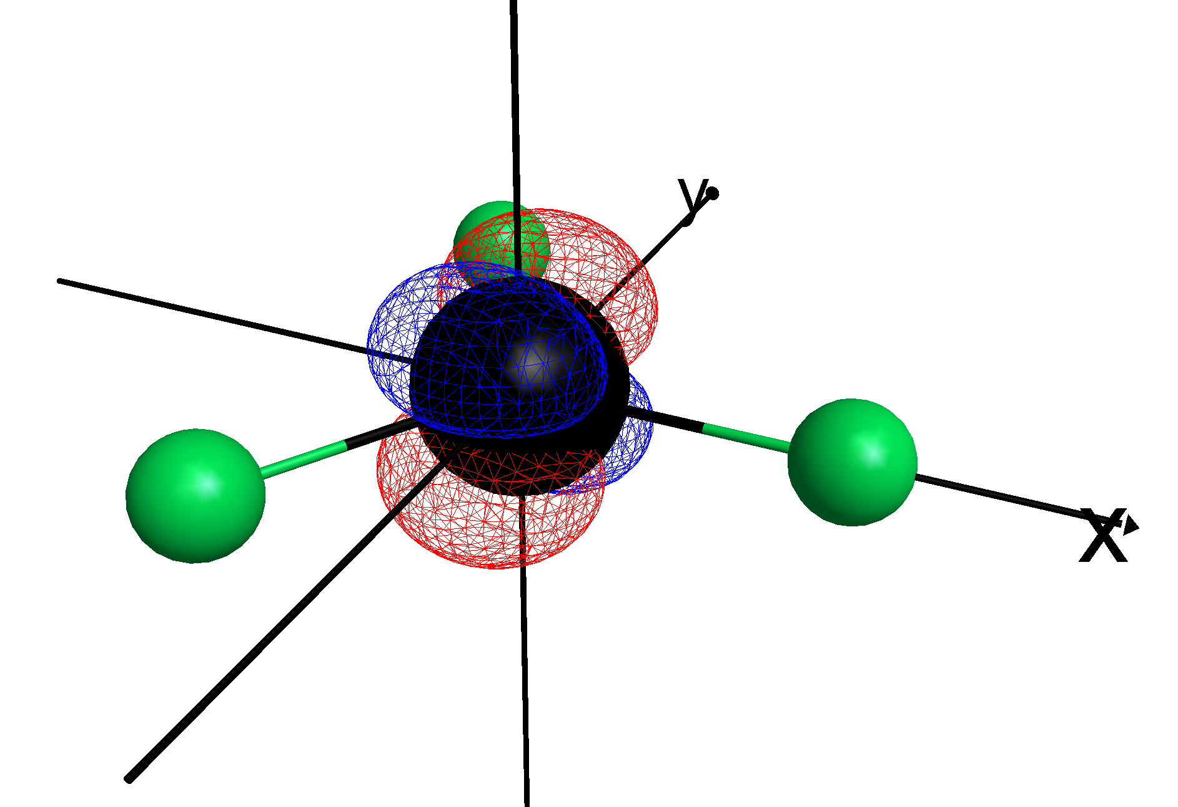
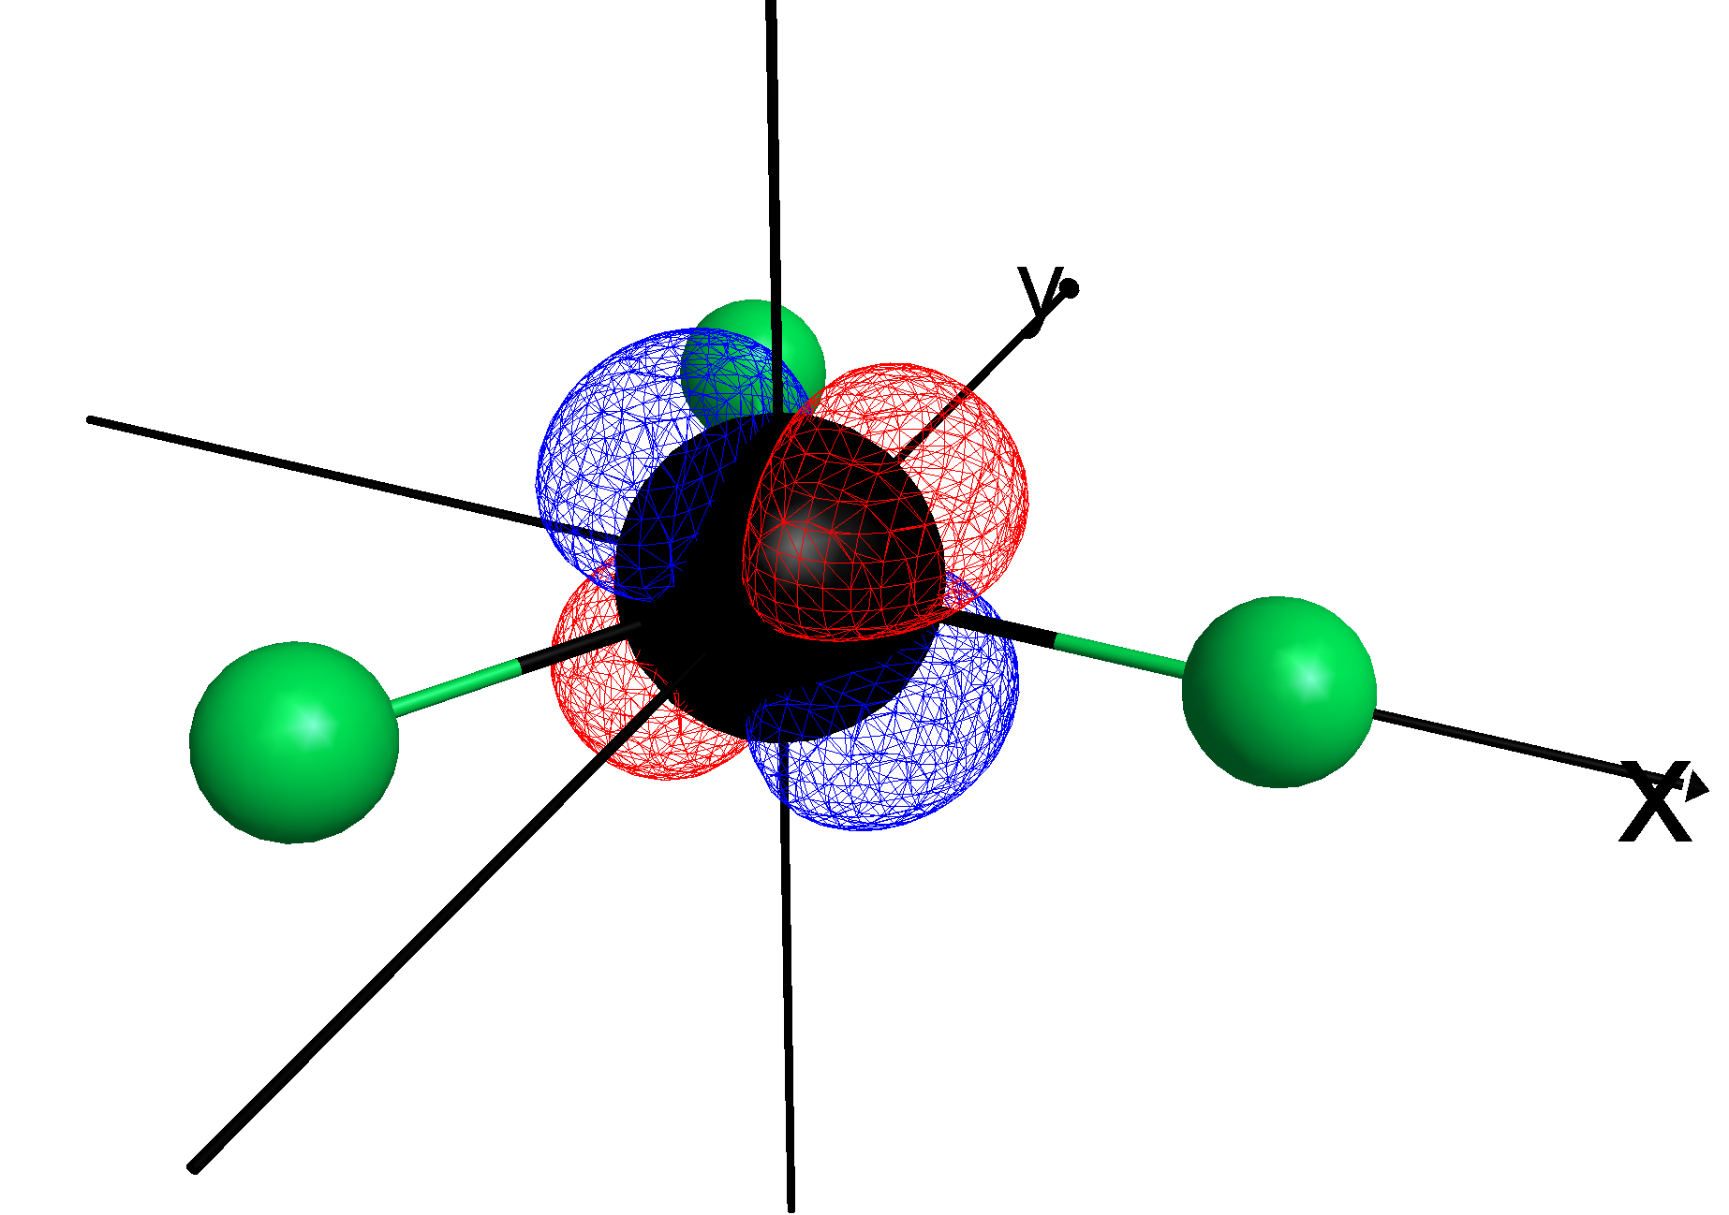
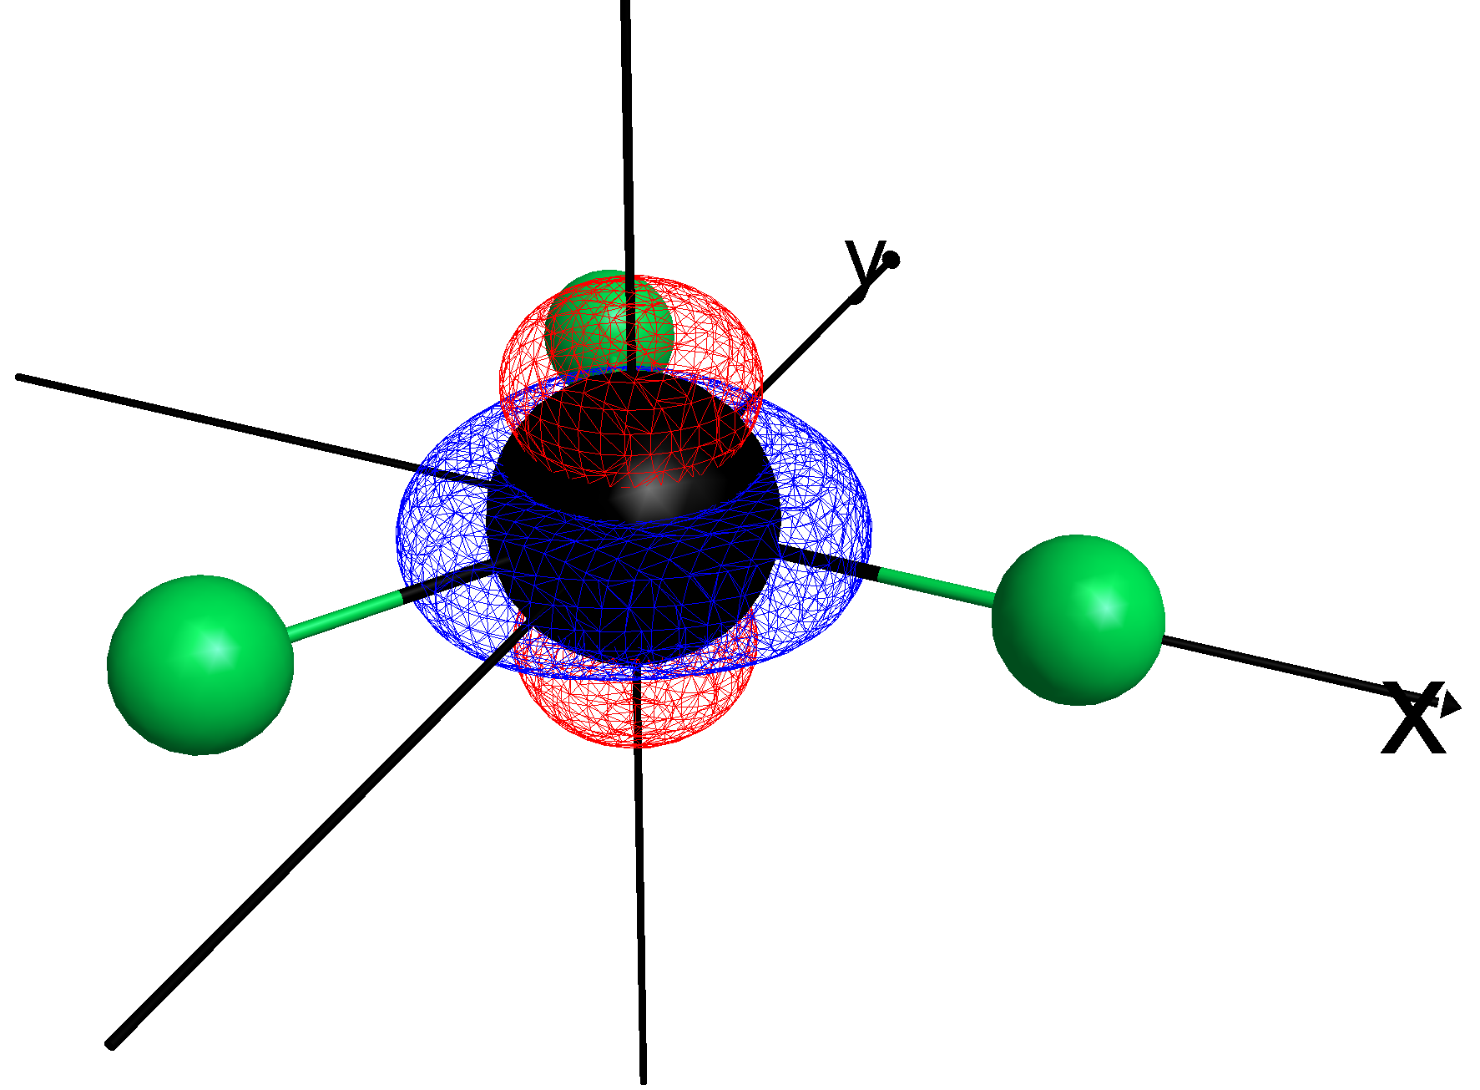
22 – 2s (A1’)
23 - 2s (E’)
24 - 2s (E’)
34 – dx²-y²
35 - dxy
36 - dyz
37 – dxz
38 - dz²
Notes:
M always increases or decreases by 1 under ladder operators acting.

Slide 9
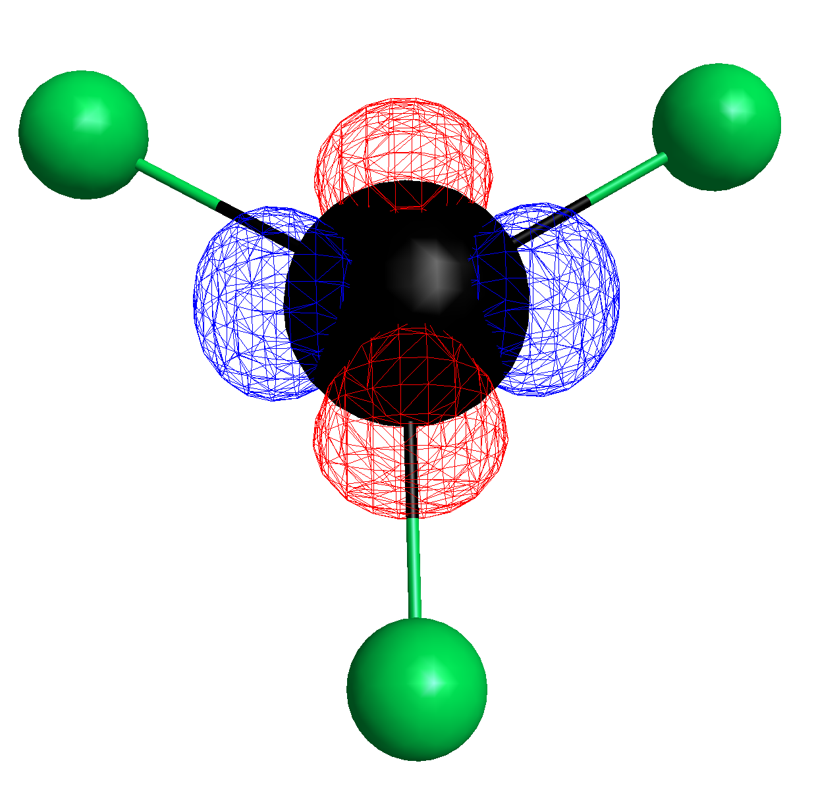
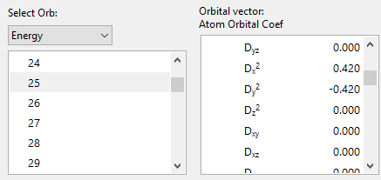
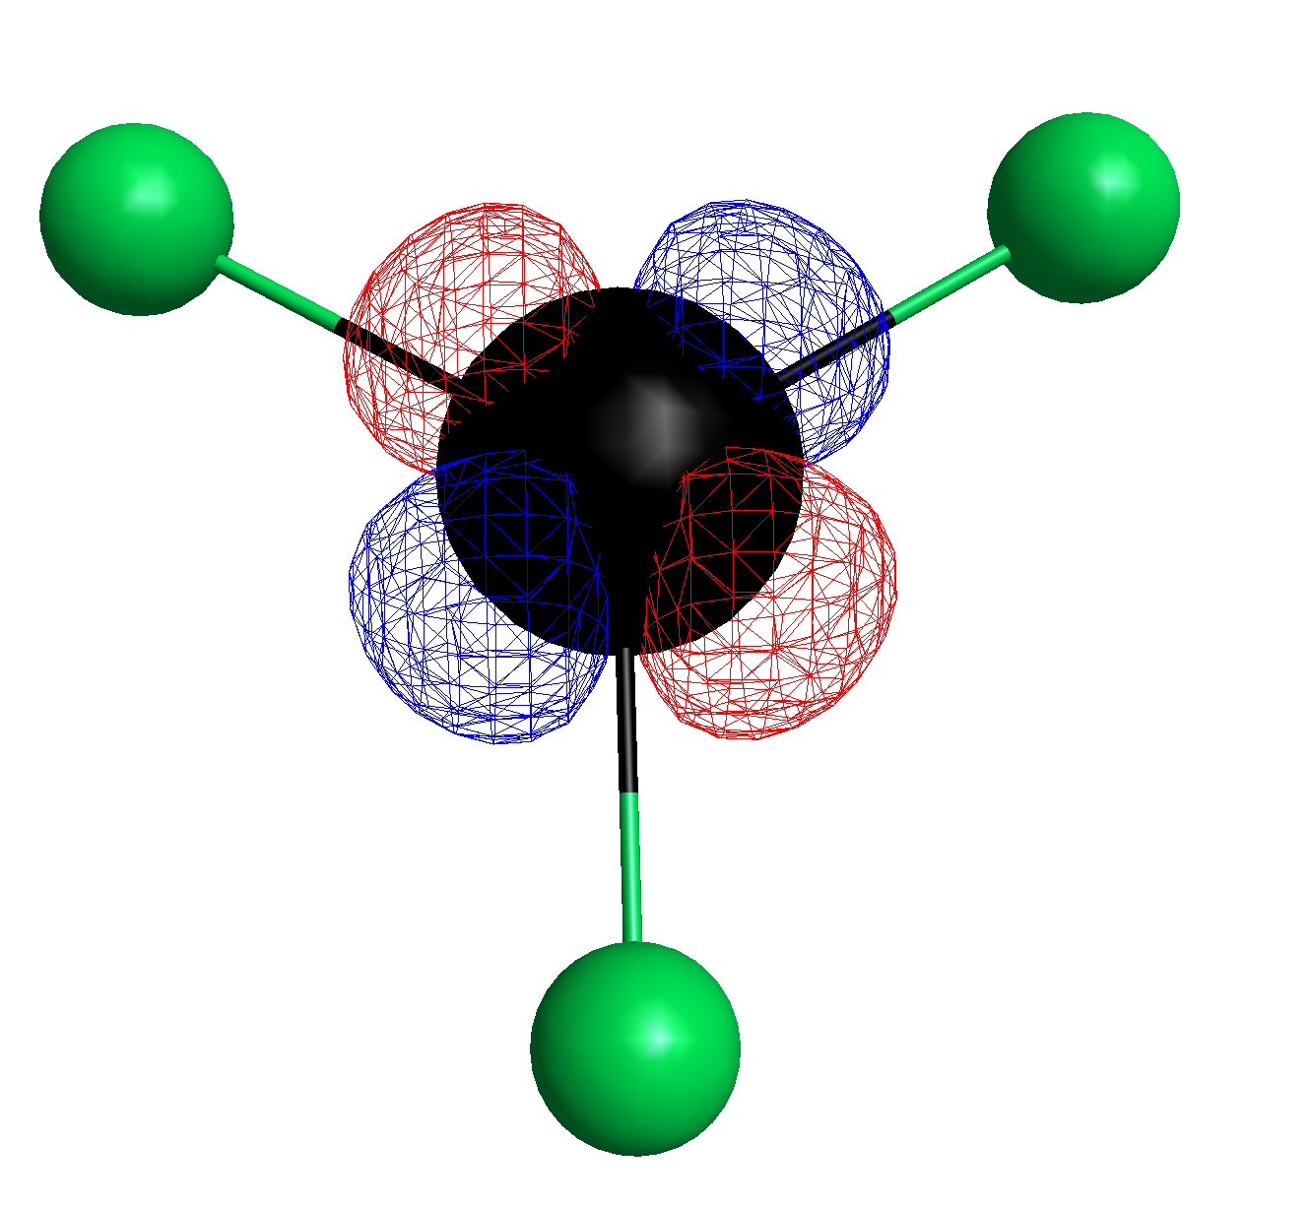
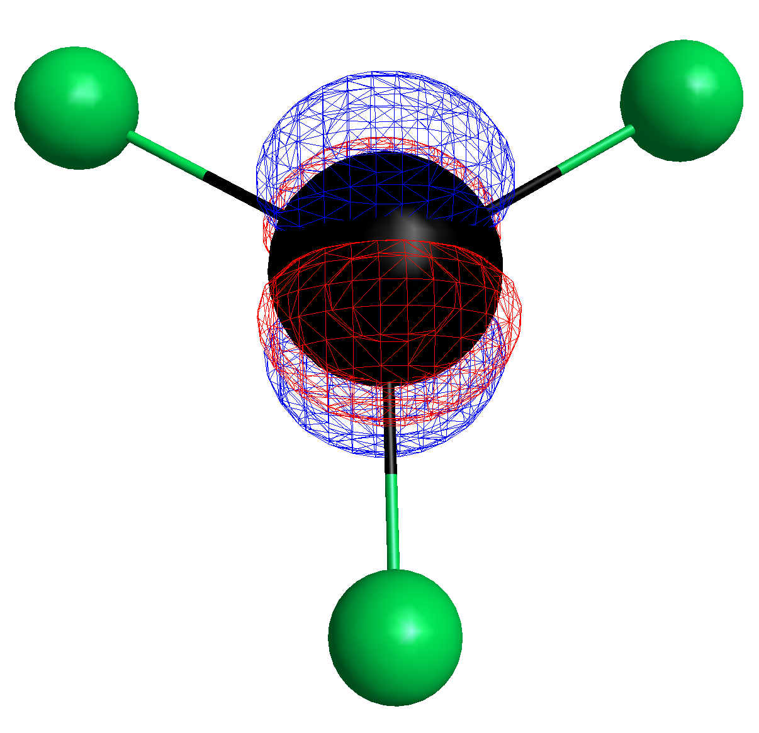
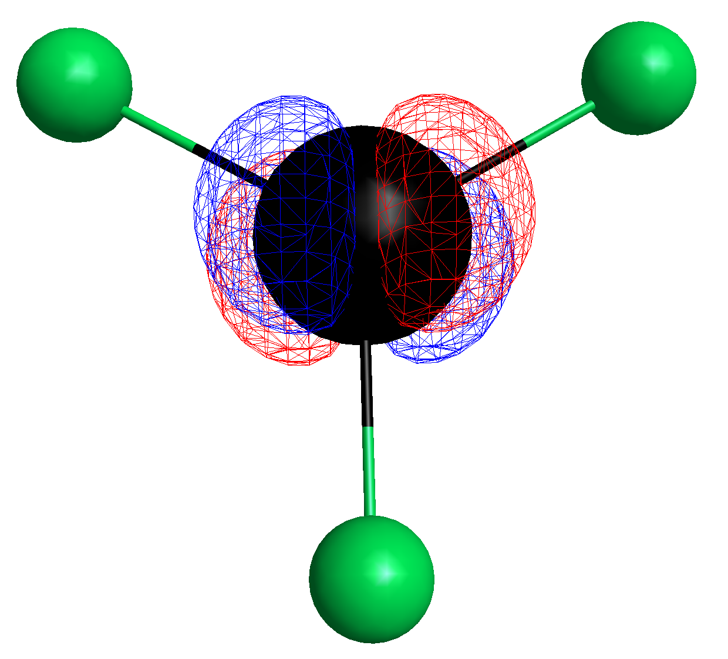
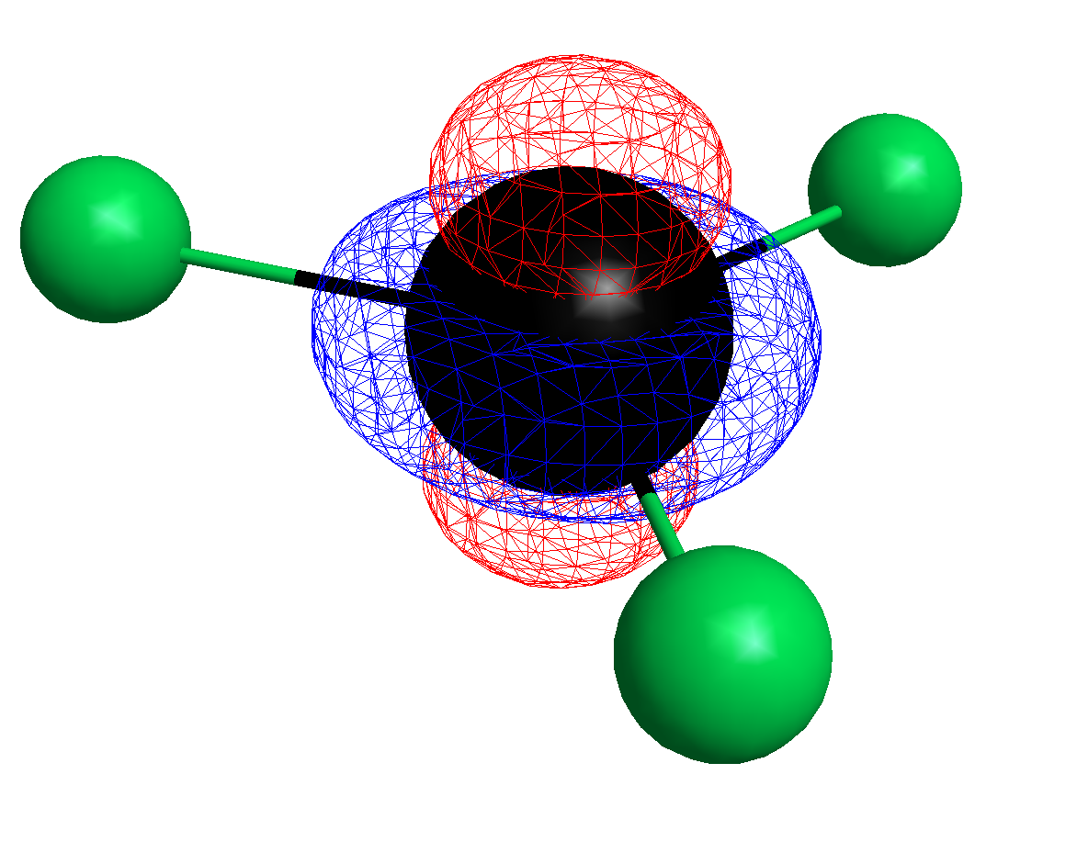
RhF3, 6 valence electrons (24+ charge cation)
d-orbs became immediately after HOMO 24,,
so 25-29 are now d-orbs
We can now look at MOs instead
of molecular eigenvects
25 - dx²-y²
26 - dxy
27 - dyz
28 – dxz
29 - dz²

Slide 10
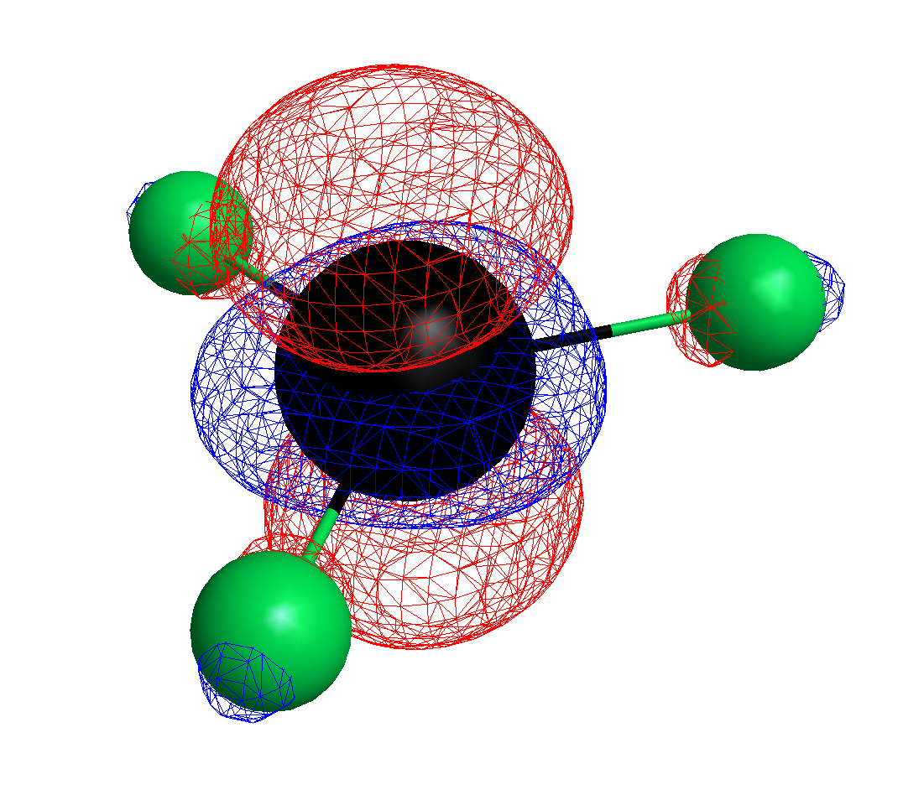
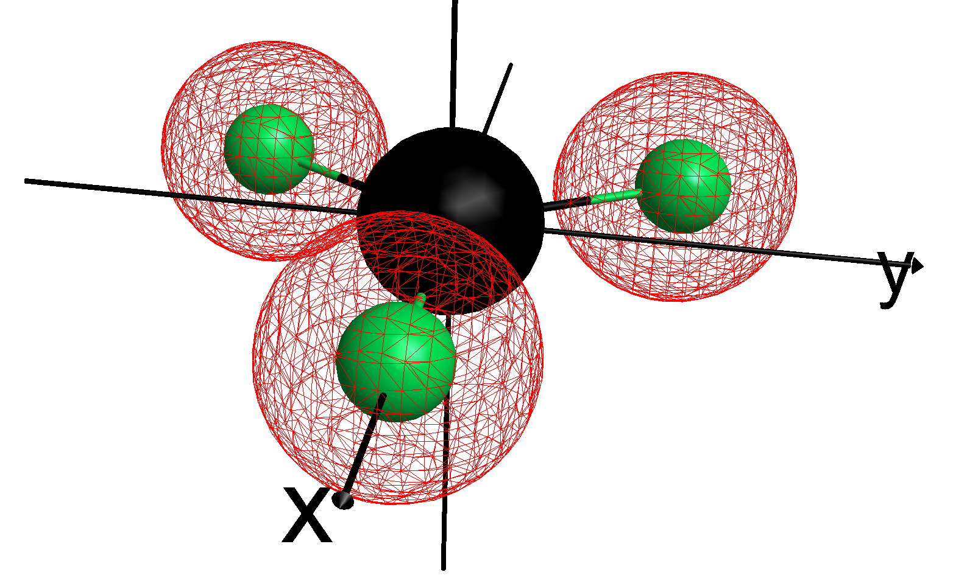
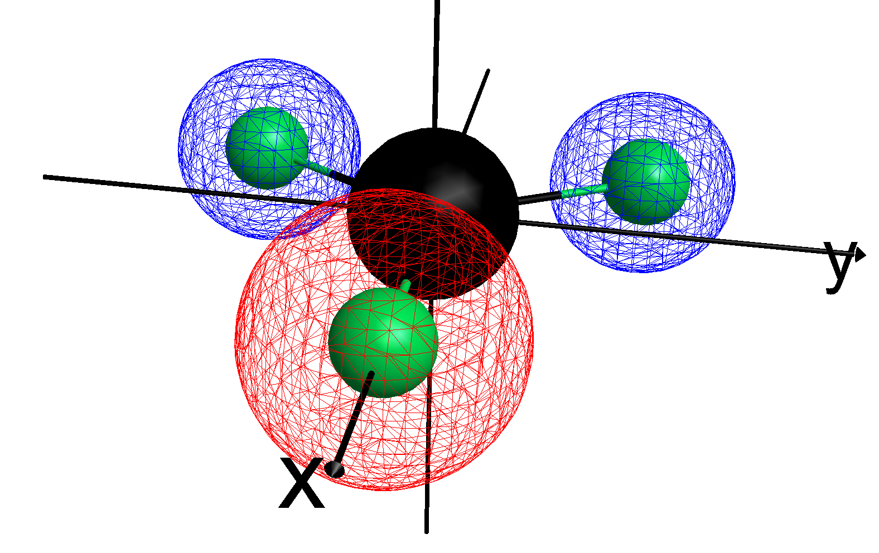
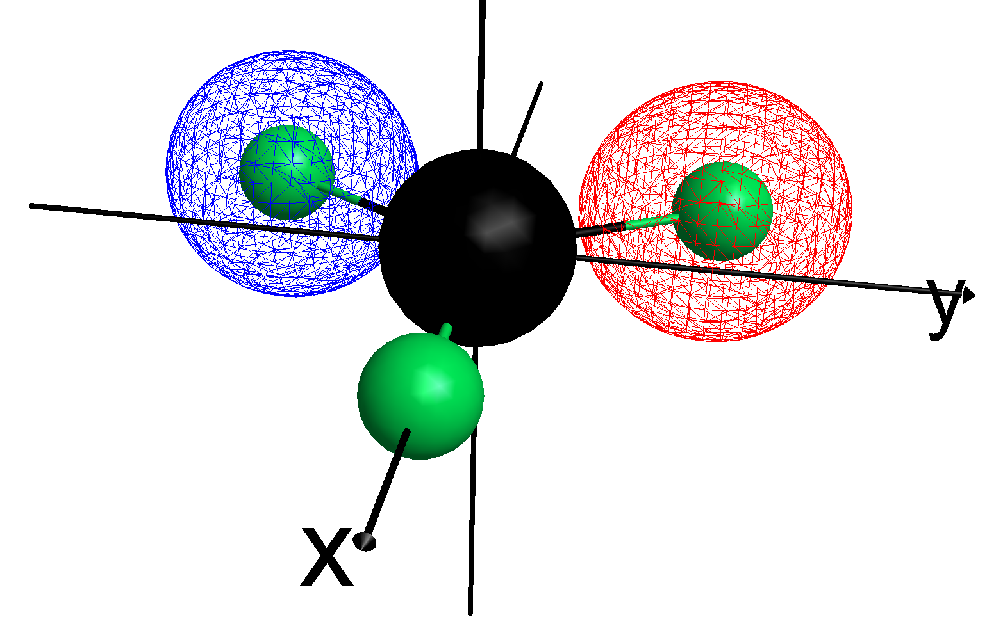
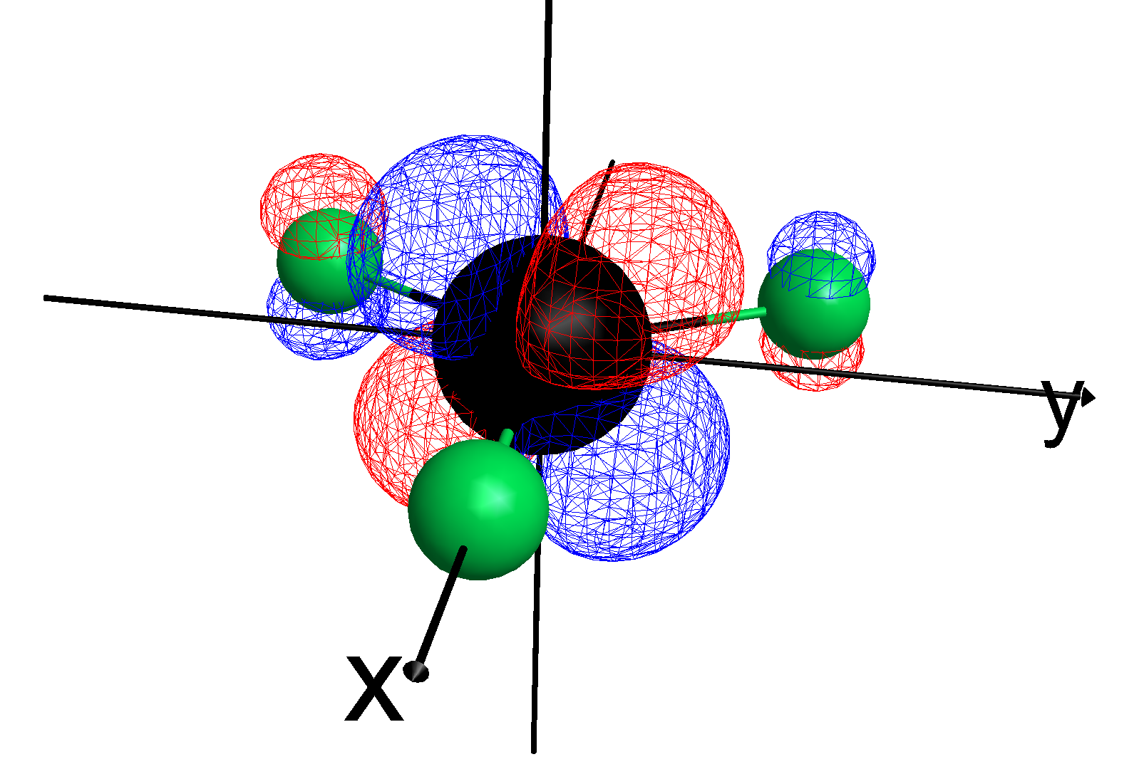
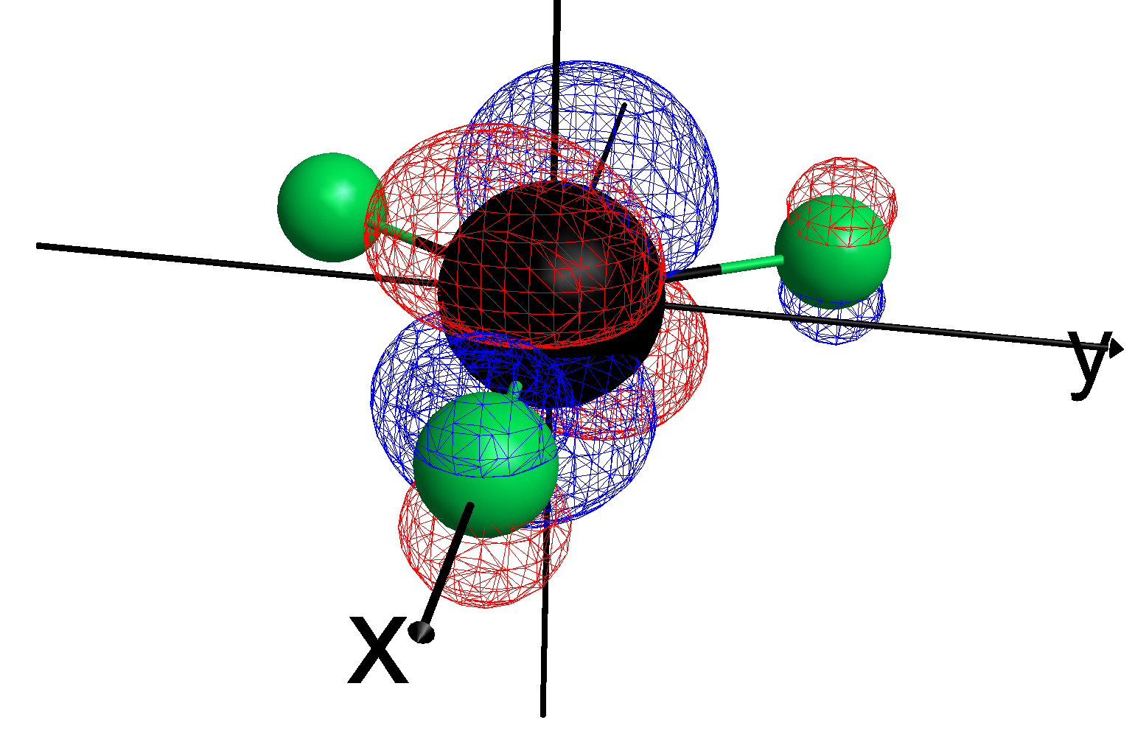
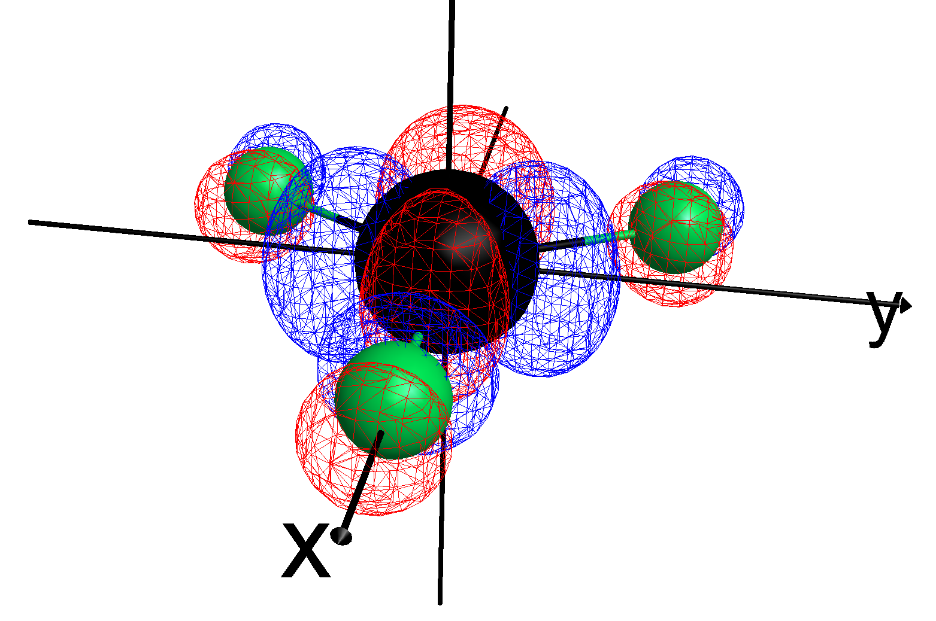
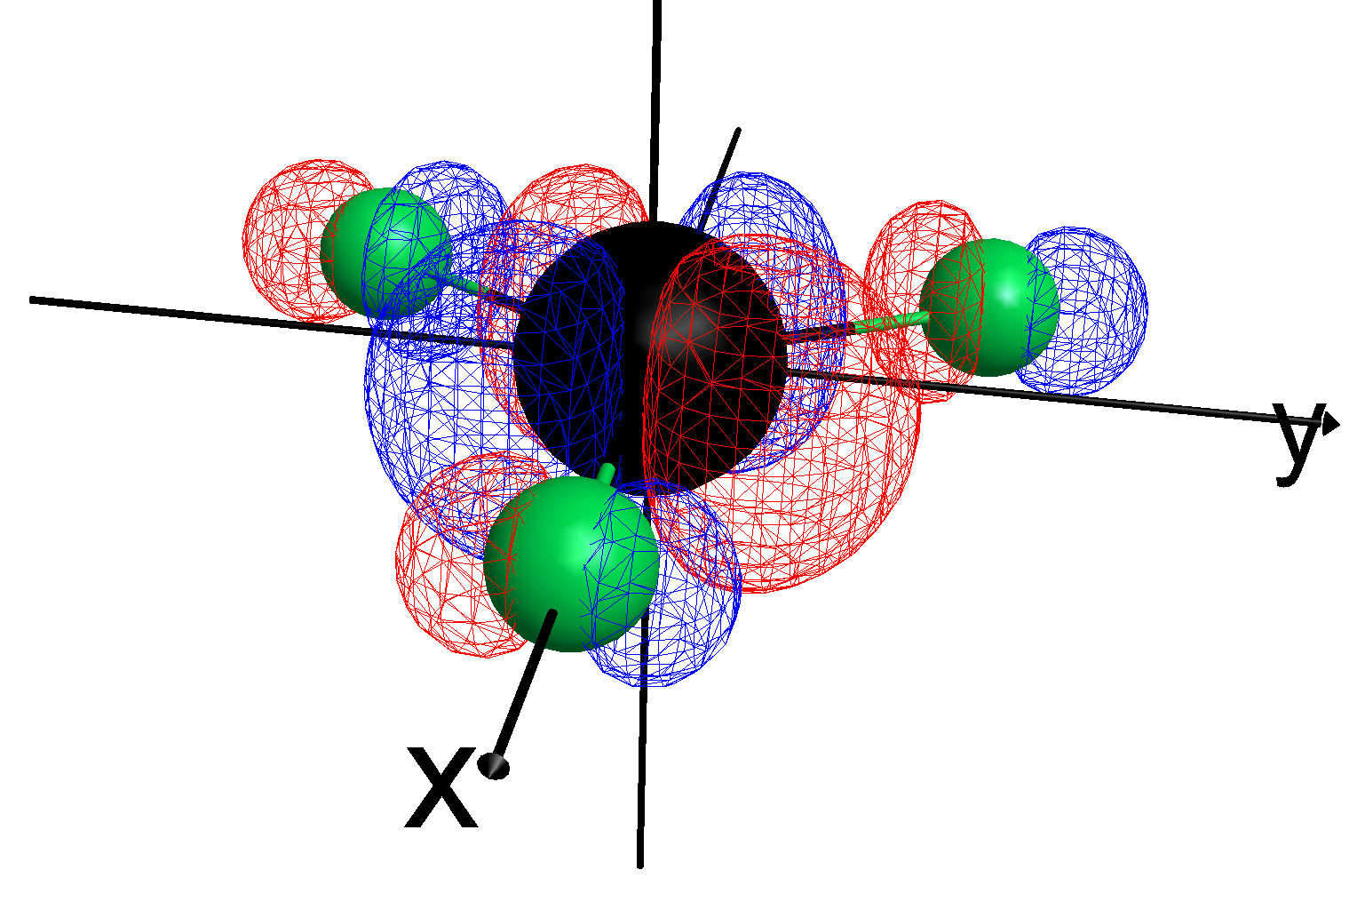
22 – 2s (A1’)
23 - 2s (E’)
24 - 2s (E’)
34 – dz²
35 - dyz
36 – dxz
19 – dx²-y²
38 – dxy
Notes:
M always increases or decreases by 1 under ladder operators acting.

